Slide 1
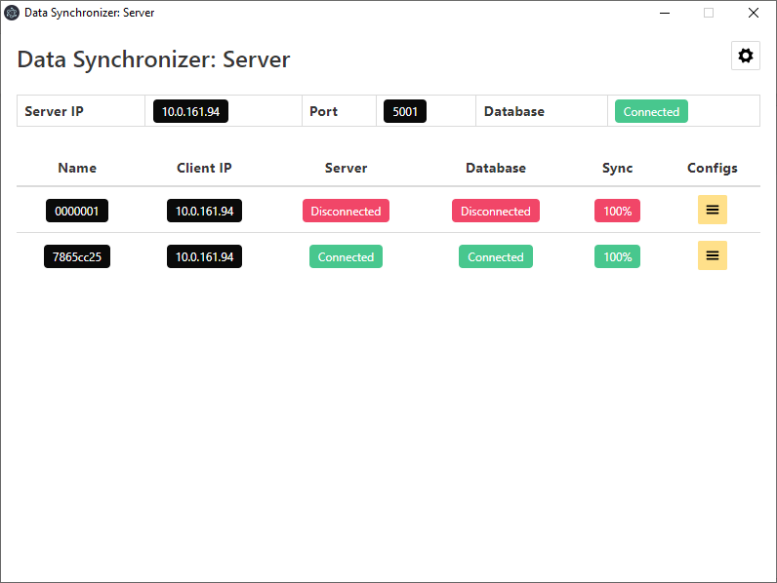

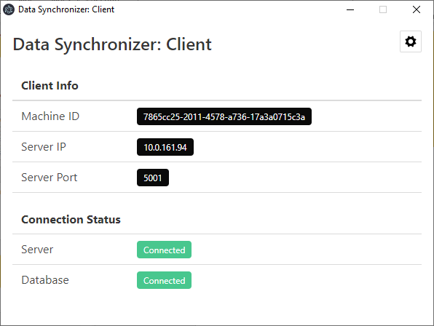
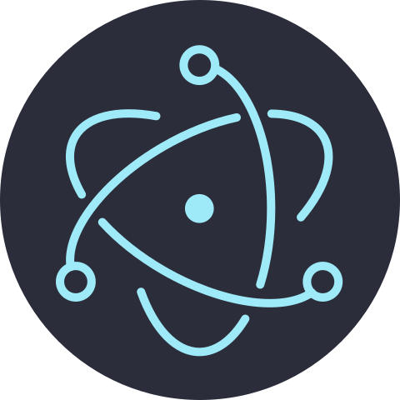

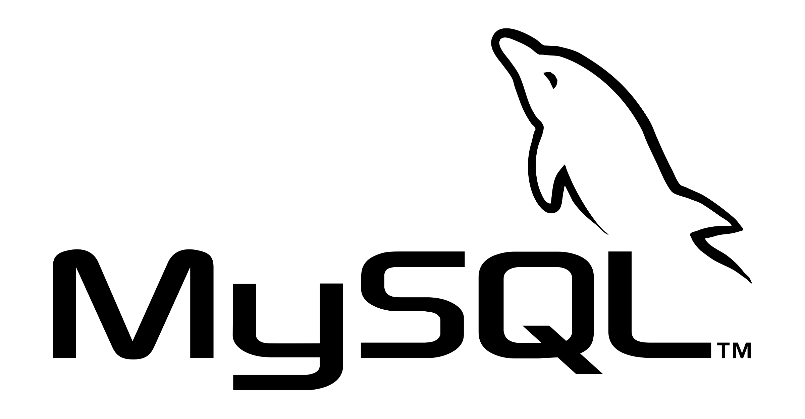
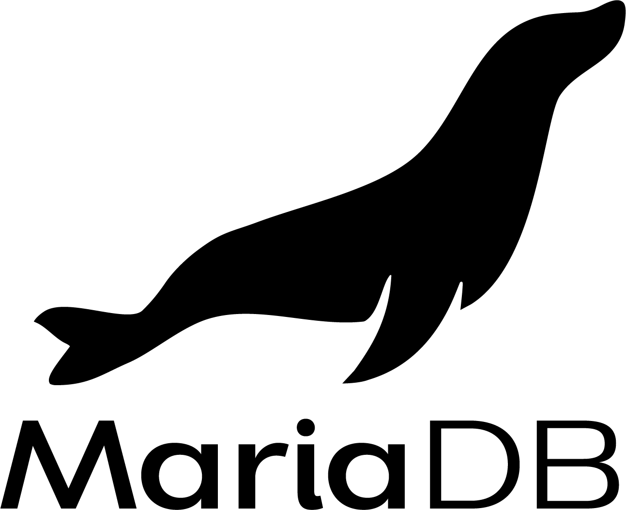


Data Synchronizer
erman999

Slide 2
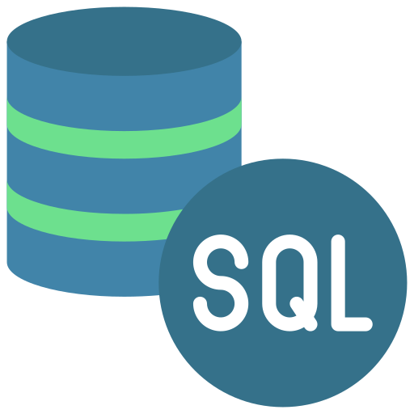
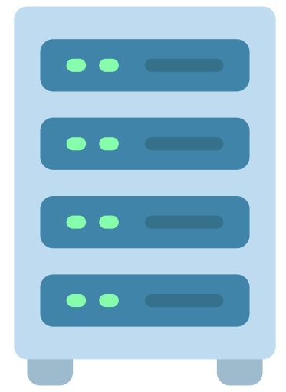
Introduction
Clients
Data Synchronizer is a Node.js Electron application that synchronizes MySQL/MariaDB data from client to server uses Socket.io for connecting and emitting data.
Purpose of this application is to transfer clients' SQL data to server continuously.
Server

Slide 3
Applications
Client
Connects to SQL server, receives requests and sends back to server
Server
Collects data from clients, synchronize them to target databases

Slide 4
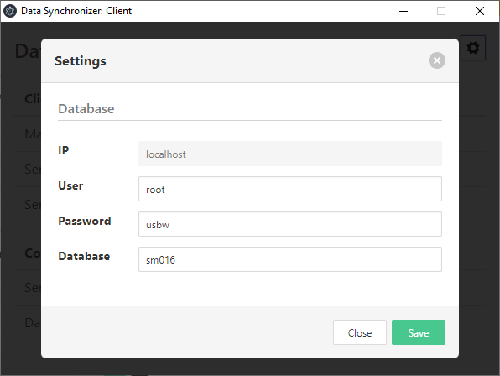
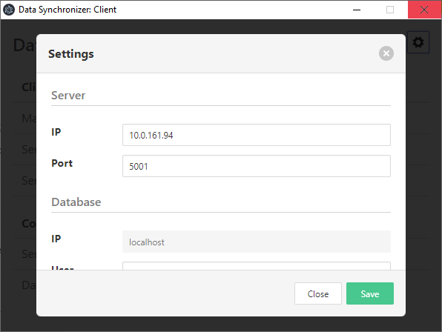
Client Settings
Click 'Cog' button to open settings.
Enter Server IP address and Port credentials. (These informations can also be collected from Server application)
Enter Database credentials. (Database name is case-sensitive)
Click save button and restart application
Settings will be valid after restart

Slide 5

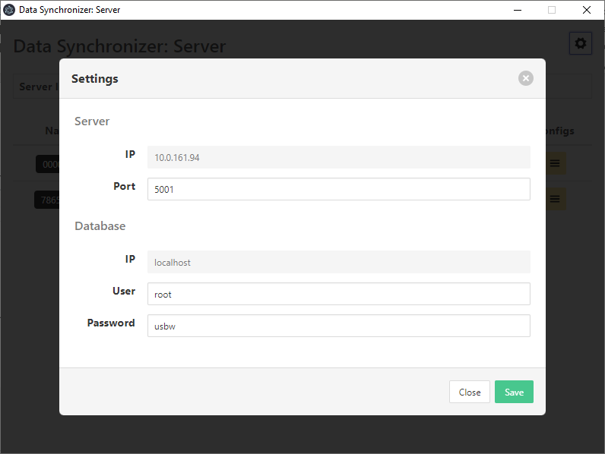
Server Settings
Click 'Cog' button to open settings.
Enter Port credential. Enter Database credentials. (Database name is case-sensitive)
Click save button and restart application
Settings will be valid after restart

Slide 6
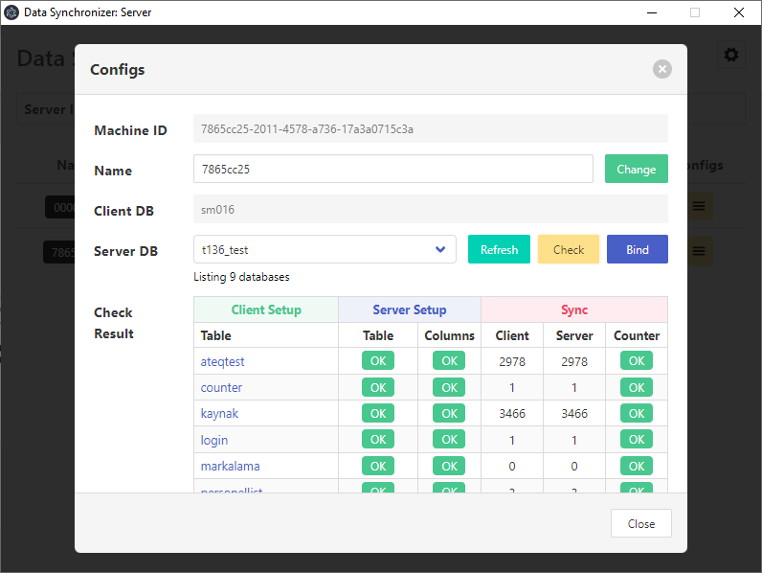
Database Binding
Click Client's 'Config' button to open client configuration window.
Choose target database
Click 'Check' button to compare Client & Server database match
If check is successfull 'Bind' button will be activated.
Click 'Bind' button to bind Client database to selected server database.

Slide 7
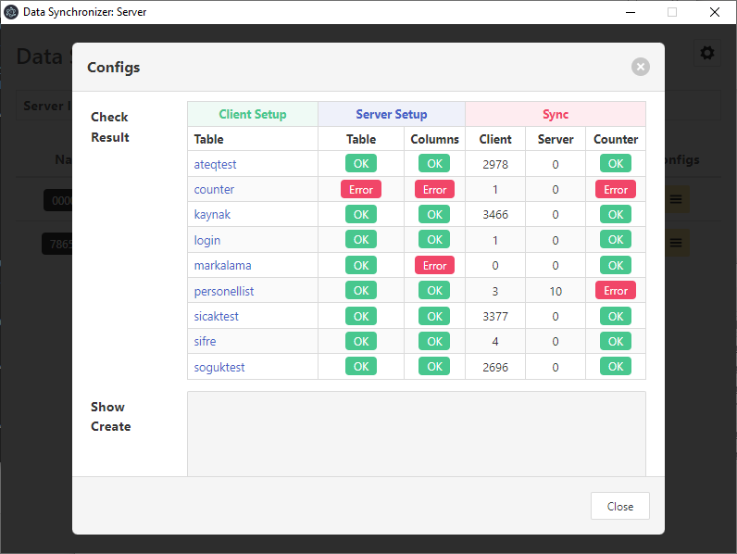
Database Binding Errors
Check result will be shown in 'Check Result' table.
If 'Table' has an error, table is missing.
If 'Columns' have an error, table column name, data type or key does not match.
If 'Counter' has an error this means Server has more records than client. (Counter error does not prevent binding)

Slide 8
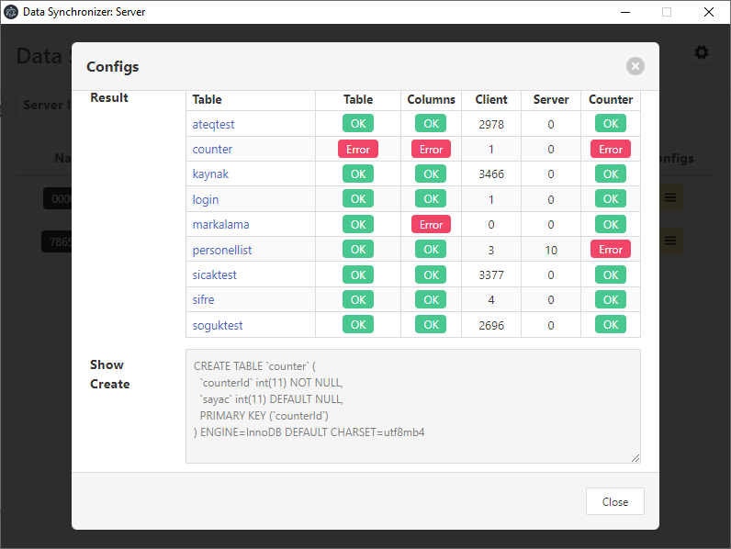
Fixing Binding Errors
If 'Table' or 'Columns' gives error,

Slide 9
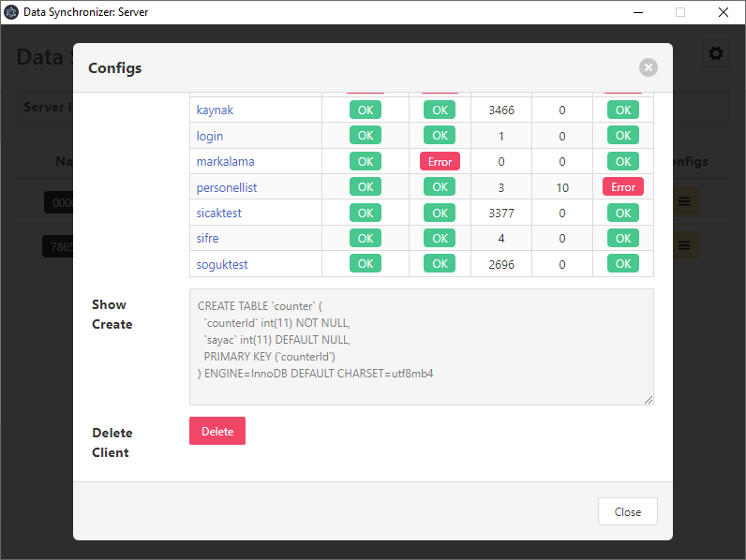
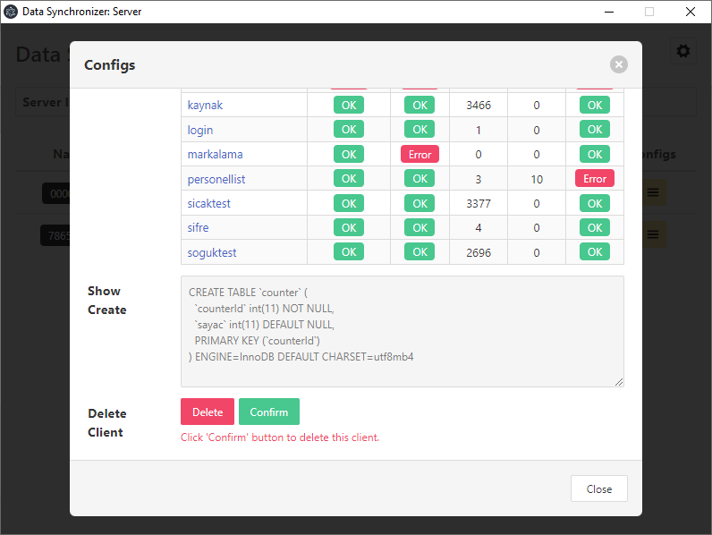
Delete Client
If 'Table' or 'Columns' gives error,

Slide 10

Delete Client
If 'Table' or 'Columns' gives error,

Slide 11
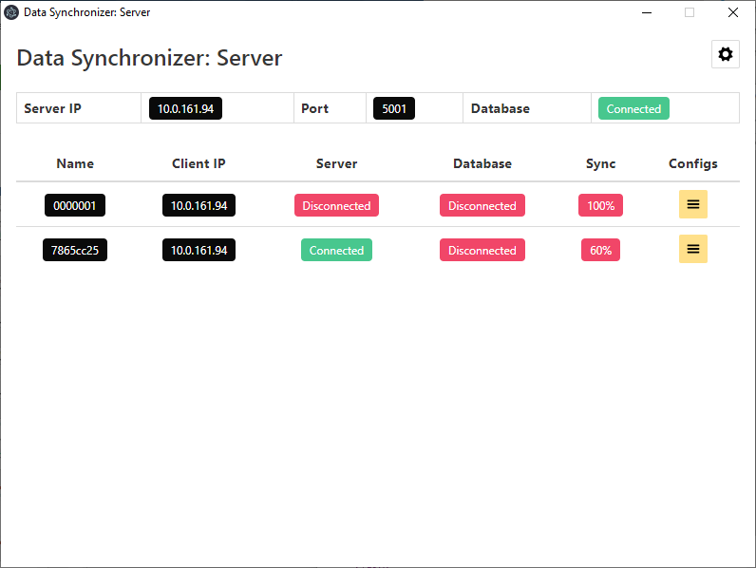
Delete Client
If 'Table' or 'Columns' gives error,

Slide 14
Thanks
Do you have
any questions?
erman.ilcin@gmail.com

